Slide 1
Sept. 14, 2024 Service Change
Changes for Riders
Edmonds Civic Roundtable – Sept. 5

Slide 2
Agenda
Introductions
CT service and how to pay
Service change overview
Edmonds area changes
How to learn more
Notes:
CHELSEA
Introductions
Time for questions at the end

Slide 3
Community Transit Services
Getting you from where you are to where you want to be
Bus
Zip Alderwood Shuttle
Swift
Park & Rides
DART
Transit Centers
Vanpool

Slide 4
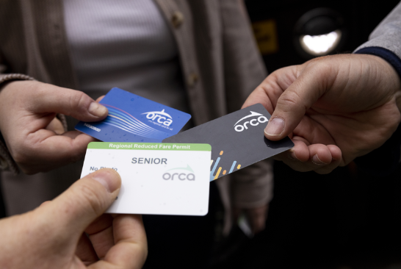
How to Pay
Get an ORCA card:
Make sure you get the right card for you (adult, senior, youth, disabled, reduced fare)
Buy:
Online at myorca.com
In person at:
Edmonds Station vending machine
QFC on 100th
Safeway on 236th and Hwy 99
Winco on Hwy 99
Ride Store at Lynnwood City Center Station
Exact change on the bus or at ticket vending machines for Swift

Slide 5
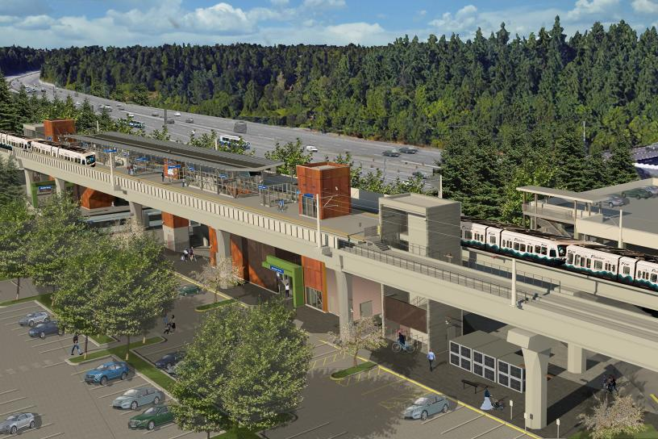
The Big Picture
Light rail is opening in Snohomish County
Need for transit changes in 2024 and beyond
Goals:
Connect to light rail
Expand access to frequent service
Respond to changing travel patterns
Focus on equitable access
Notes:
Reference midday and weekend service investments

Slide 6
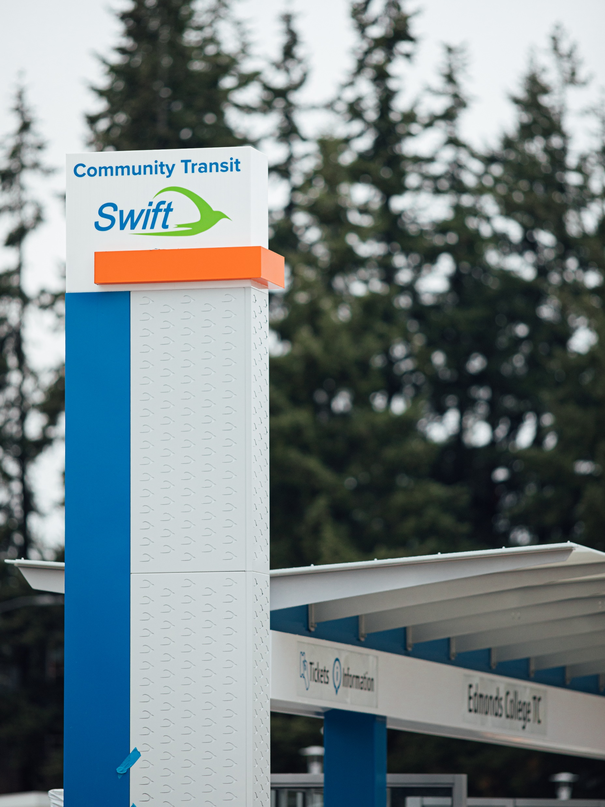
The Big Picture
Since September 2023
Large increase in service hours
Weekday: 21% increase
Saturday: 25% increase
Sunday: 32% increase
More options to connect to light rail
6x increase in trips with direct connection to light rail
Less waiting time
200% increase in weekday routes with 10 min peak frequencies
175% increase in weekday routes with 30 min peak frequencies
Notes:
Light rail coming to Snohomish County means we can offer a six-fold increase in trips that connect to light rail, and ultimately downtown Seattle. One 400 route, 424, will remain.

Slide 7
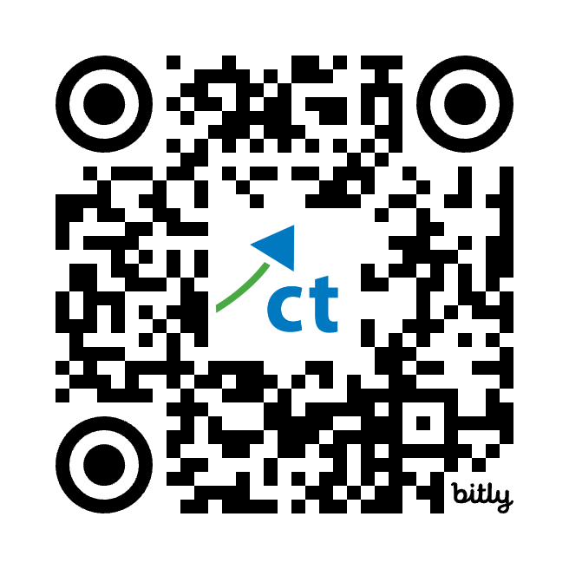
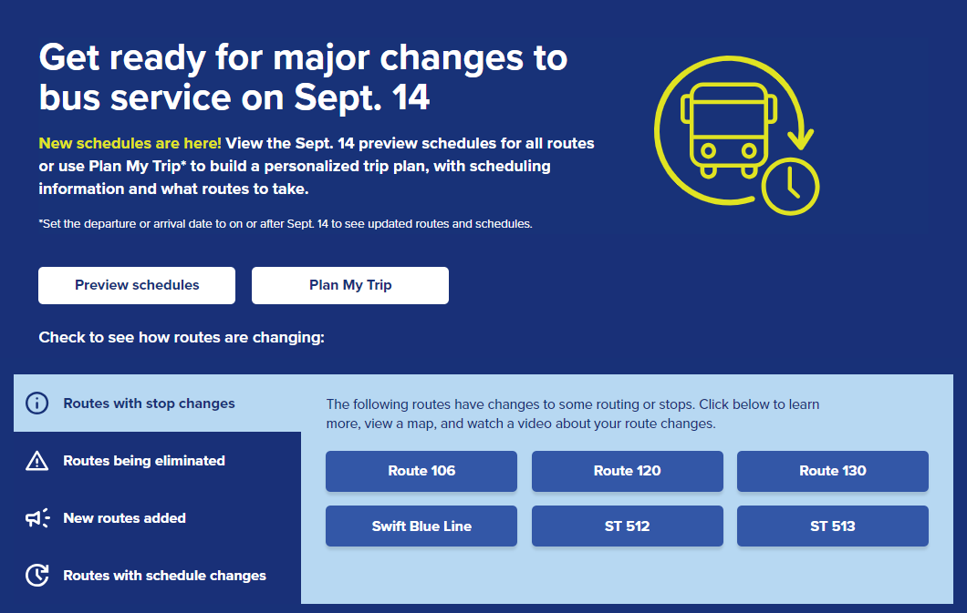
Overview of Changes: ctgo.org/sept2024
Notes:
For a list of all changes view this
A reminder that everything we’ll walk through can be found on the service change website

Slide 8
Overview of Changes
Sound Transit changes
Link 1 Line
Sounder N Line
512
513
515
New express routes
901
903
904
905
907
909
Routes being eliminated
105
107
113
227
247
402
405
410
412
413
415
416
415
416
417
421
422
425
435
810
821
860
871
880
Remaining existing commuter route
424
Routes with path changes
106
120
130
Swift Blue Line
New local routes
103
117
121

Slide 9
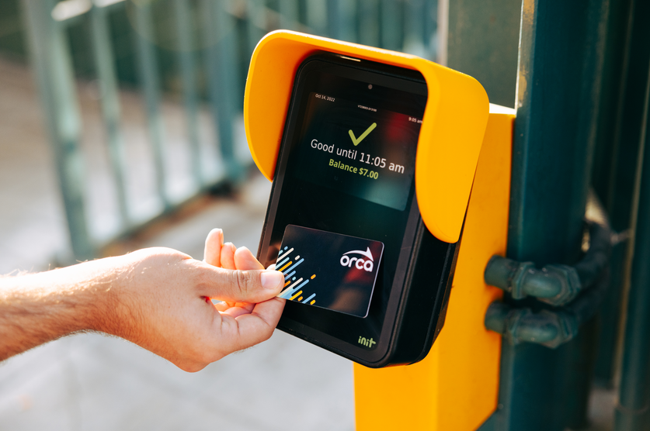
Simplified fares
Community Transit – starting Sept. 1
Adults: $2.50
Reduced: $1.25
Youth: Free
Sound Transit – starting Aug. 30
Light rail: $3 flat fare
ST Express: $3.25

Slide 10
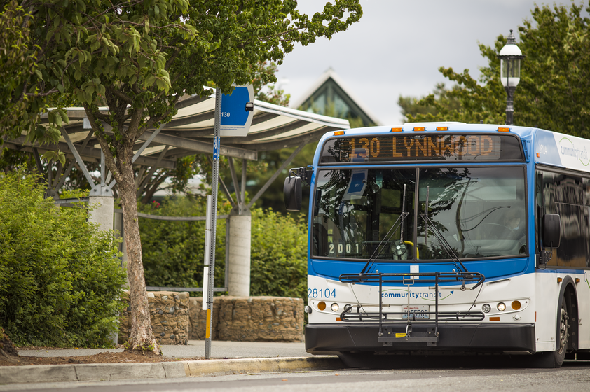
Edmonds Area Bus Service Changes
What’s changing?
Eliminated routes
405
416
871
Routes with path changes
130
Swift Blue Line
New routes
909
Check your schedule!
Minor changes to most routes
Service increases on 102, 119, 130, Swift Blue and Swift Orange lines
Notes:
Reference midday and weekend service investments

Slide 11
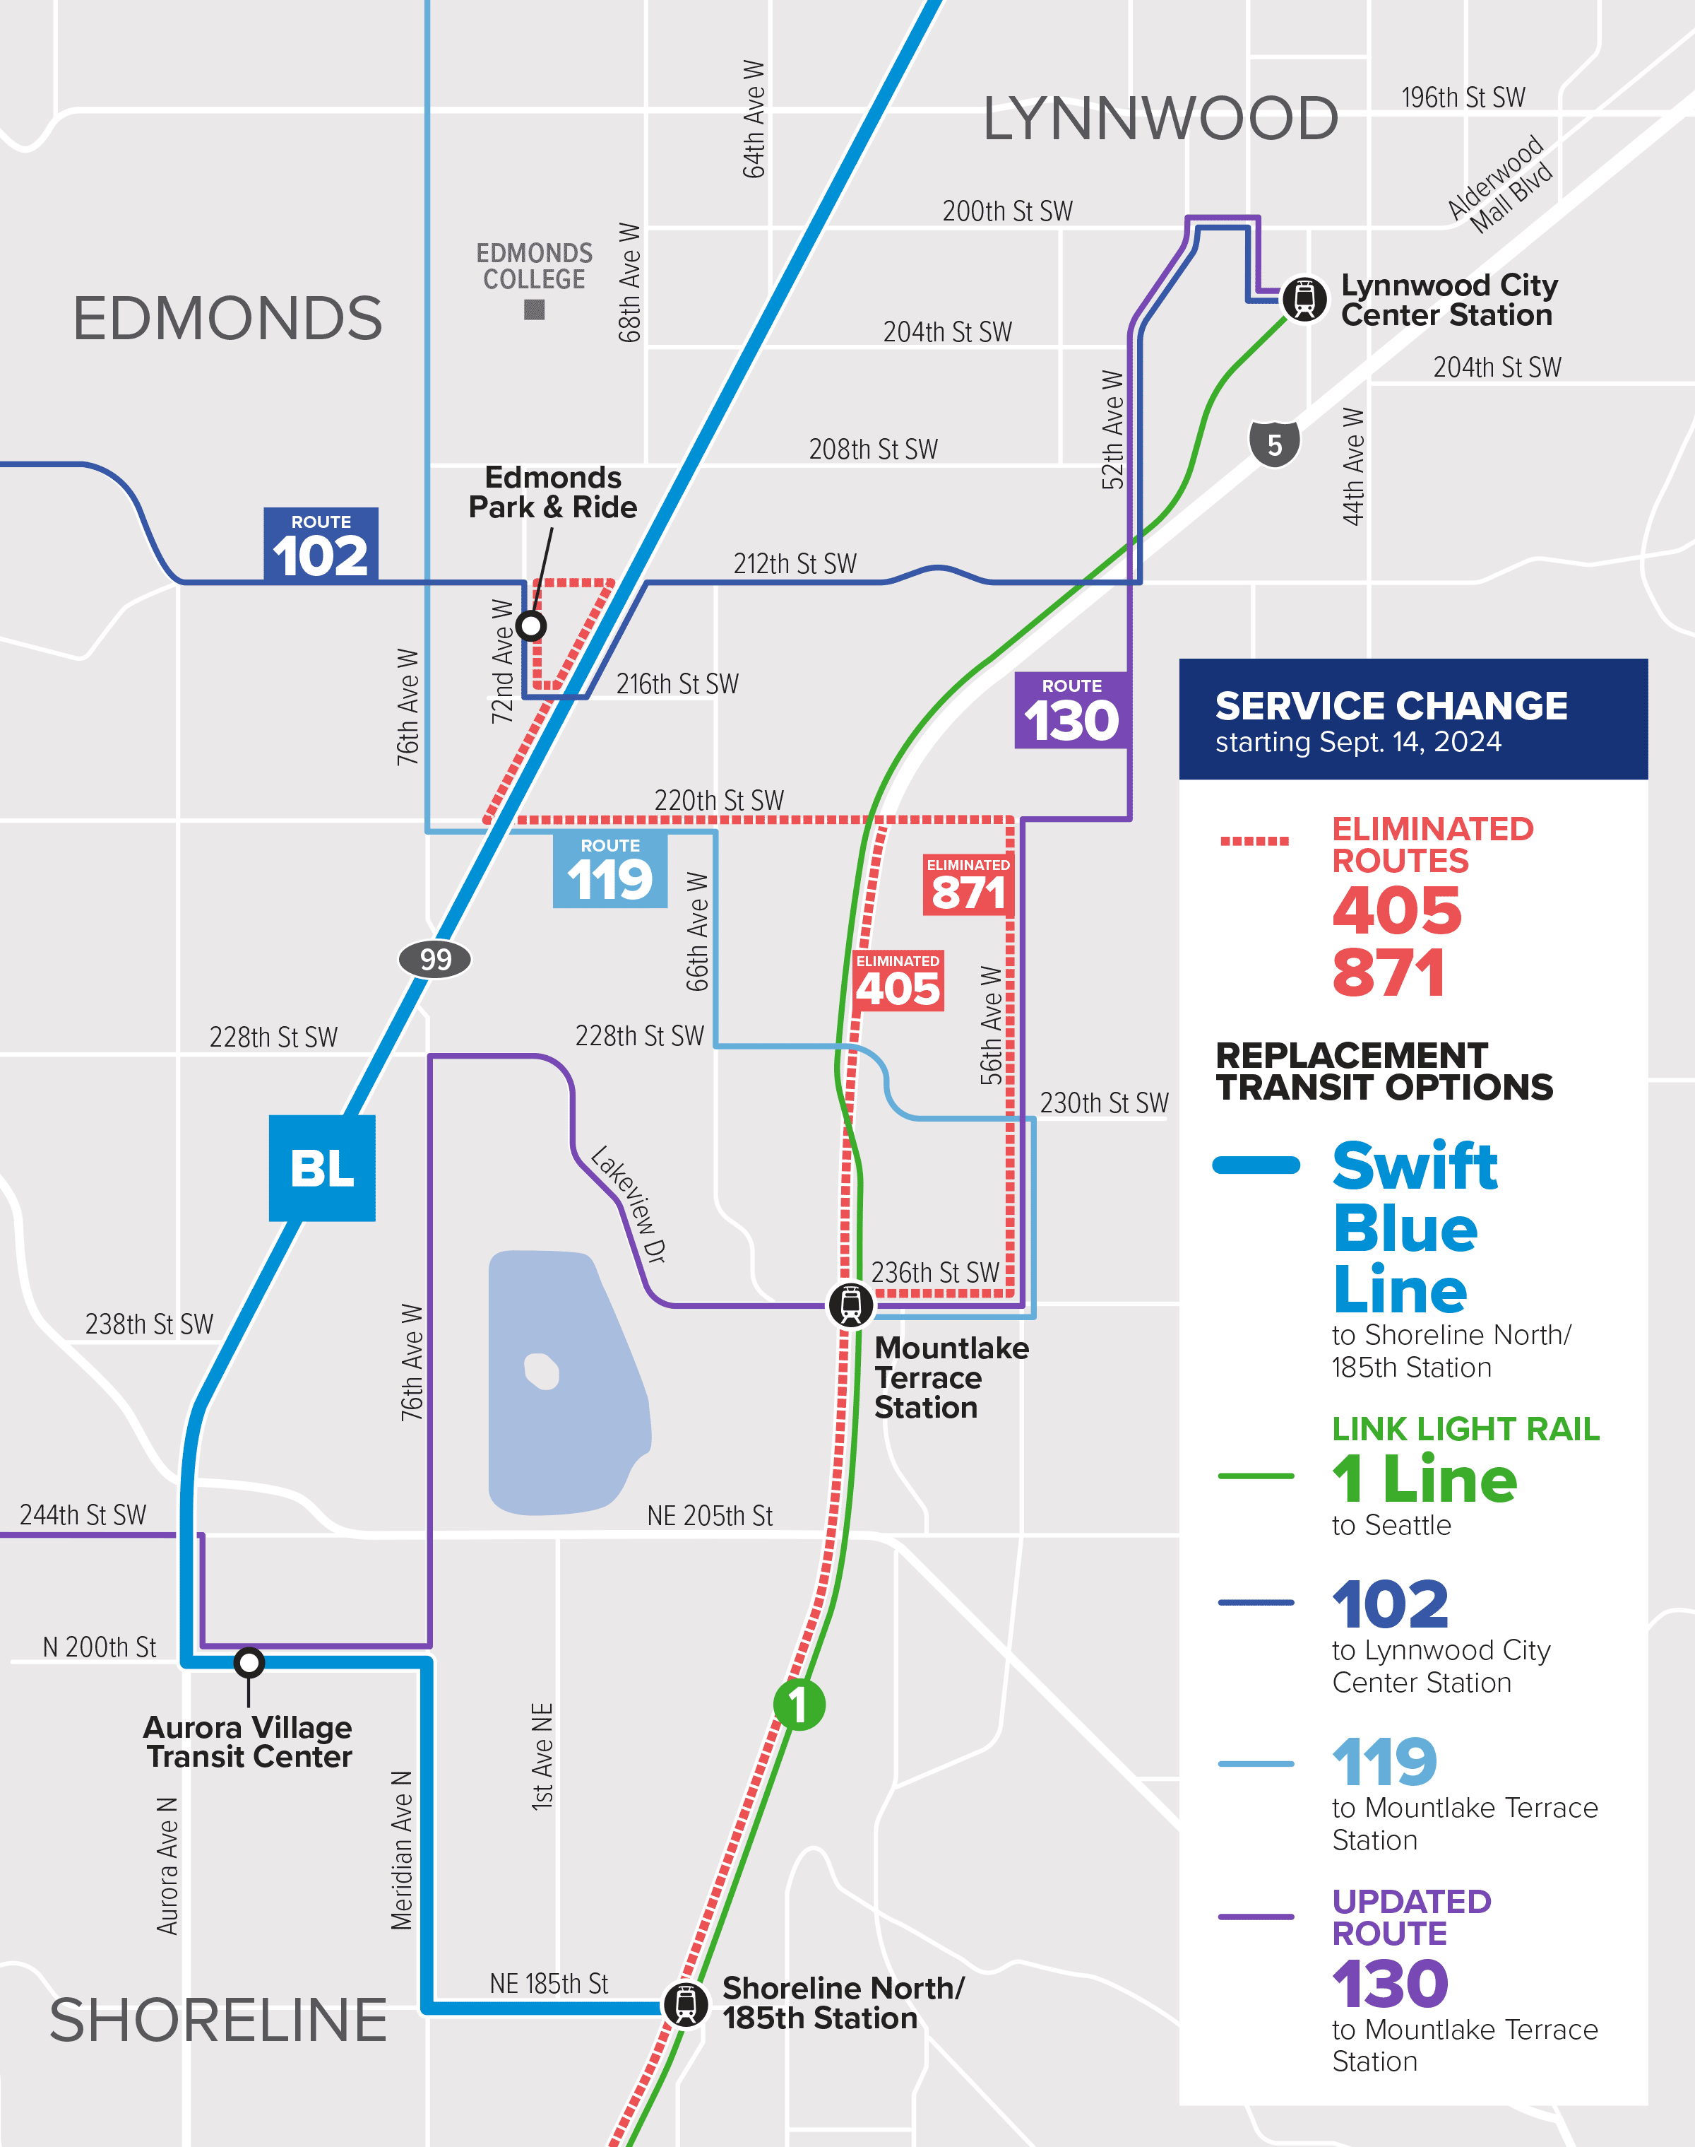
Eliminated routes
405 & 871
Your new route could be…
102 + Link 1 Line at LCC
119 + Link 1 Line at MLT
130 + Link 1 Line at MLT
Swift Blue Line
Service characteristics:
102:
All days – 30 min service all day, hourly at night
119:
Weekday – 30 min service at peak times, hourly service off peak
Weekend – hourly service
130:
Weekday – 30 min service at peak times, hourly service off peak
Weekend – hourly service

Slide 12
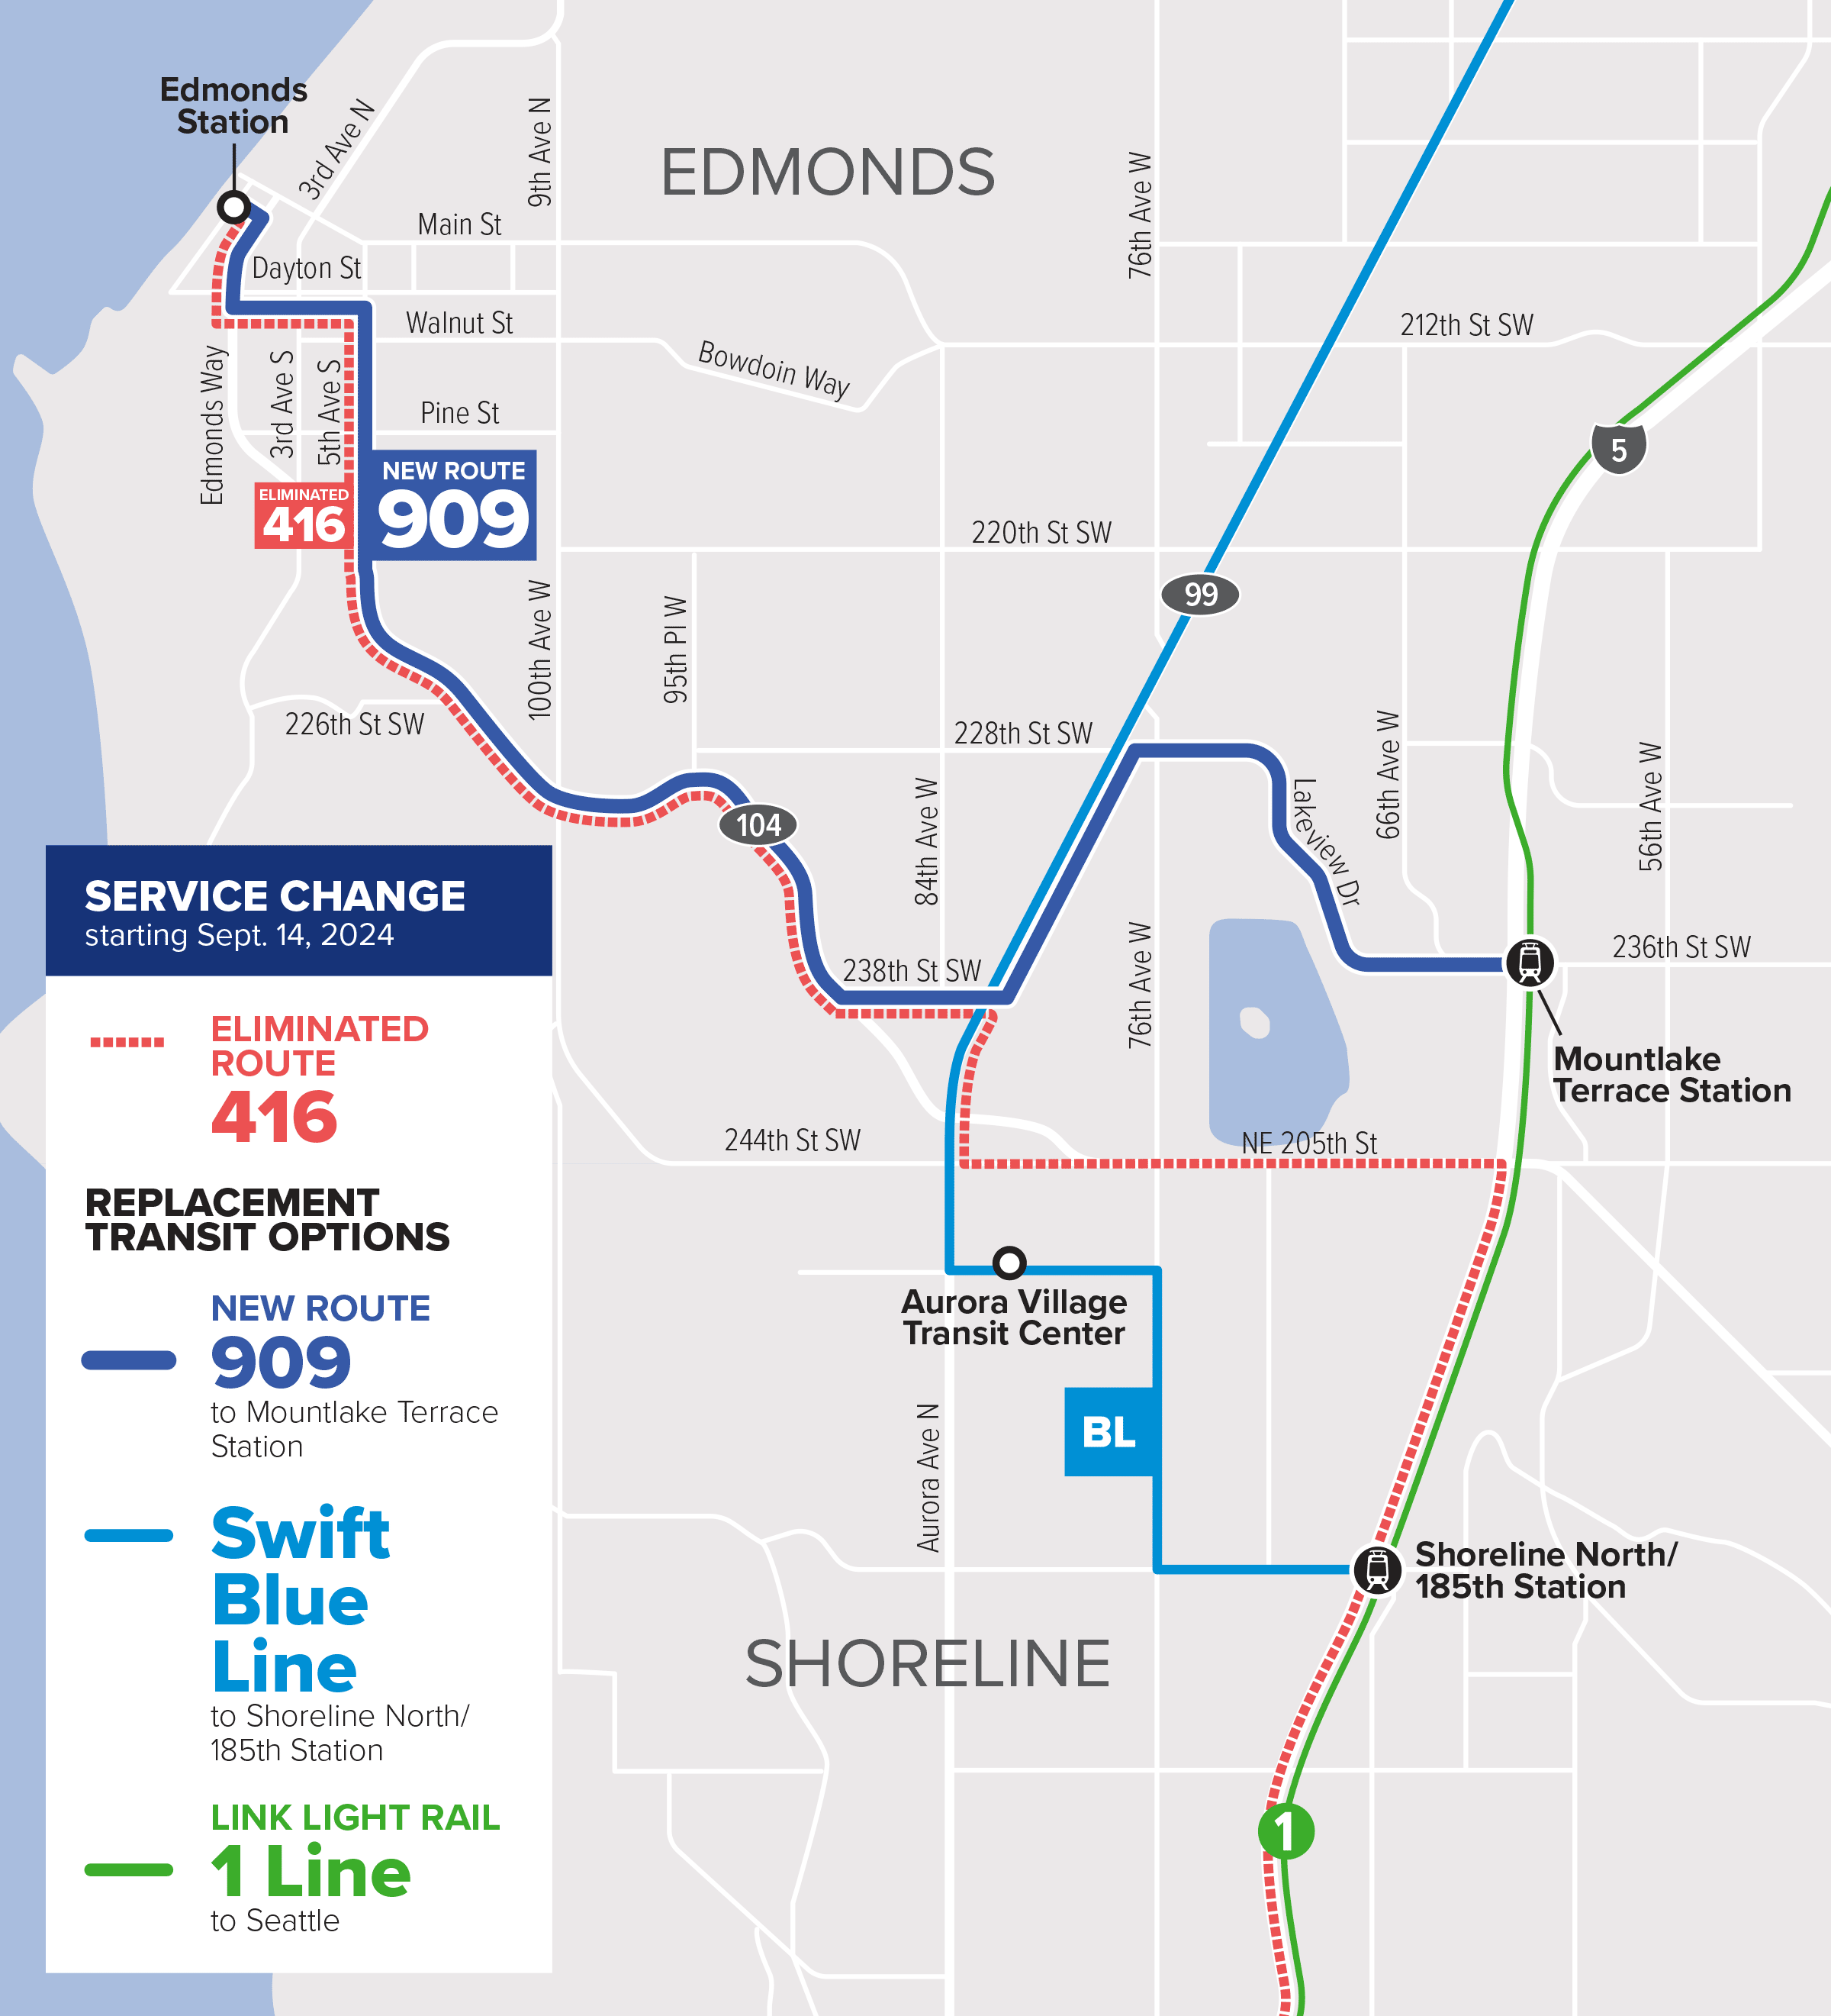
Routes with changes
416
Your new route could be…
909 + Link 1 Line
Swift Blue Line
Service characteristics:
909:
All days – ~ every 50 minutes, timed with the ferry schedule
Swift Blue Line:
Weekday – 10 min service
Early morning, evening, & weekend – 15-20 min service

Slide 13
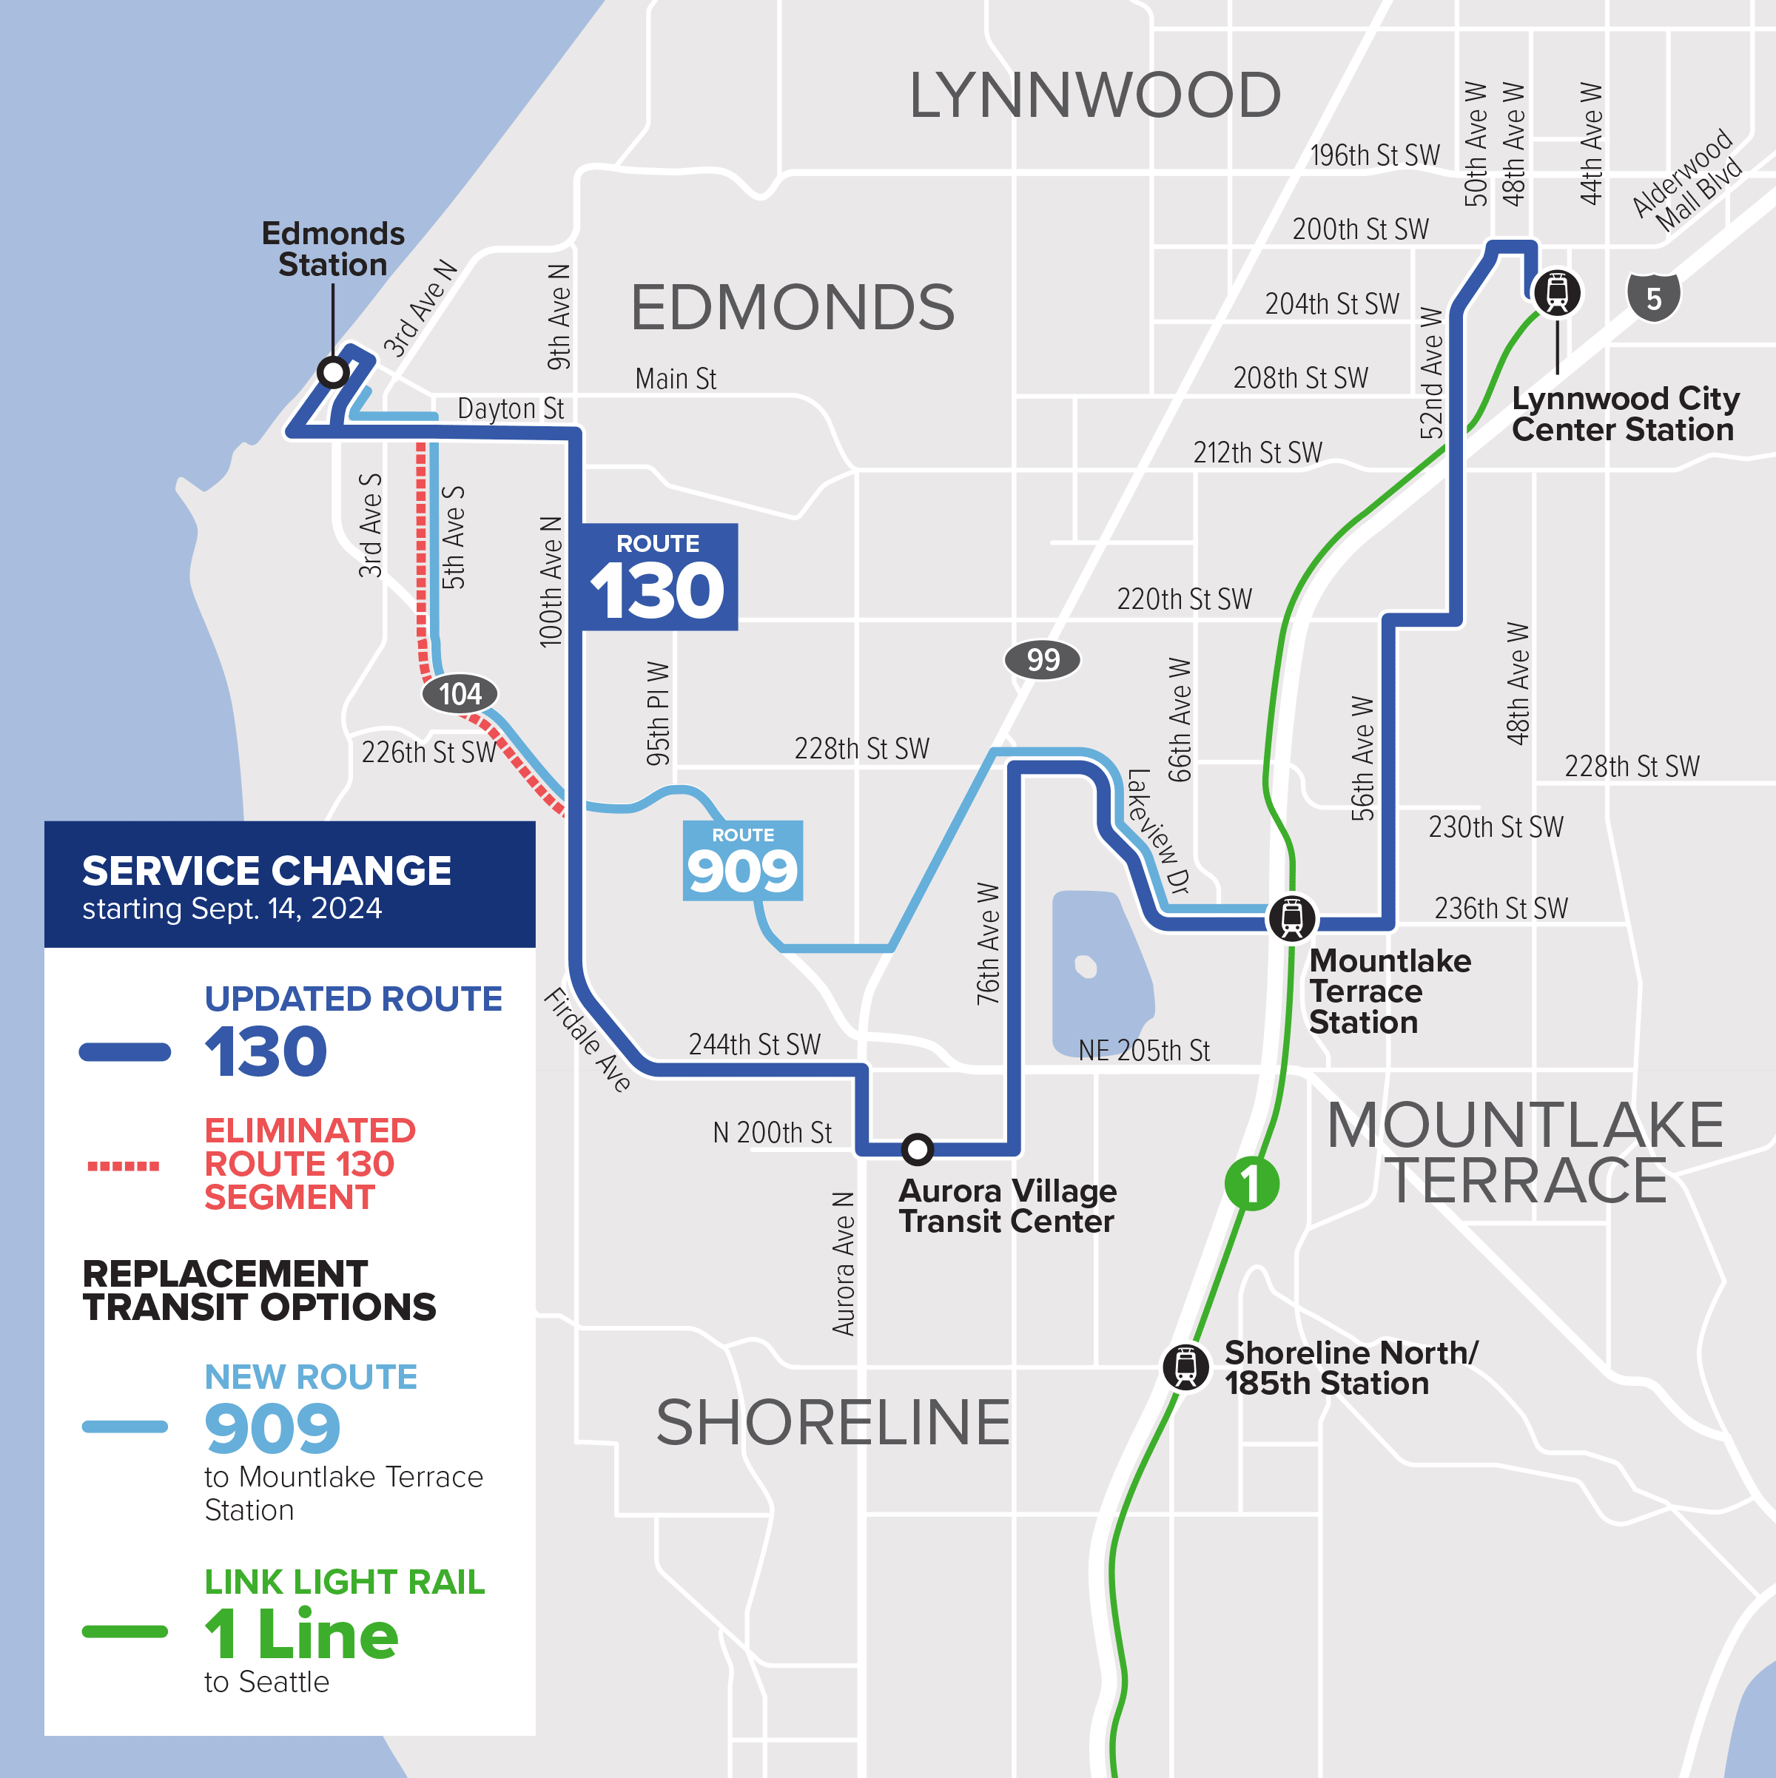
Routes with changes
130
Your new route could be…
130
909
Service characteristics:
130:
Weekday – 30 min service at peak times, hourly service off peak
Weekend – hourly service
909:
All days – ~ every 50 minutes, timed with the ferry schedule

Slide 14
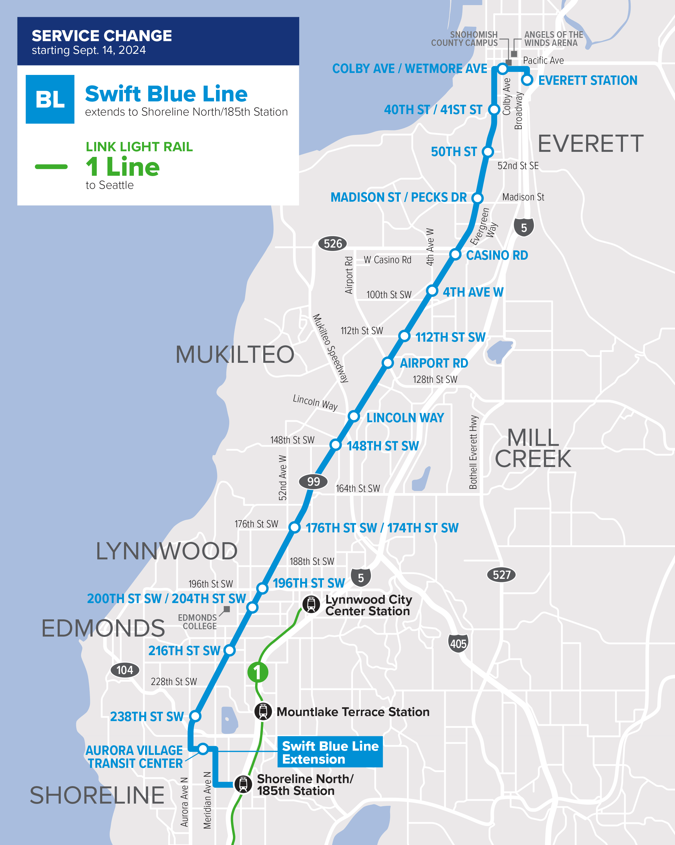
Routes with changes
Swift Blue Line
Extension from Aurora Village Transit Center to Shoreline North/185th 1 Line station
Service characteristics:
Swift Blue Line:
Weekday – 10 min service
Early morning, evening, & weekend – 15-20 min service

Slide 15
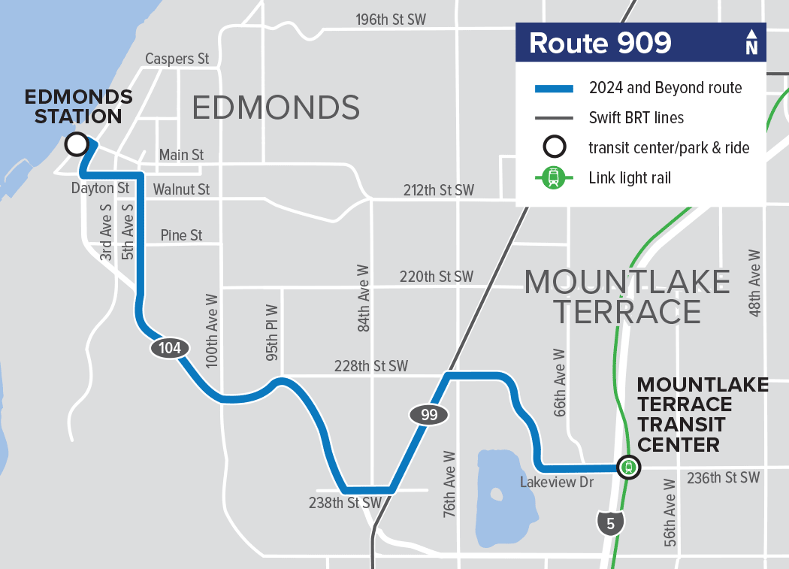
New Routes
909
Connection to MLT 1 Line station
If you ride…
130
416
909:
All days – ~ every 50 minutes, timed with the ferry schedule
Service characteristics:

Slide 16
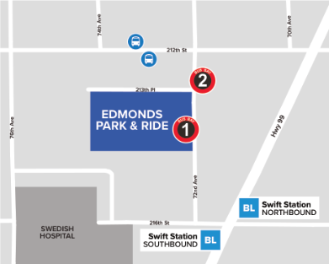
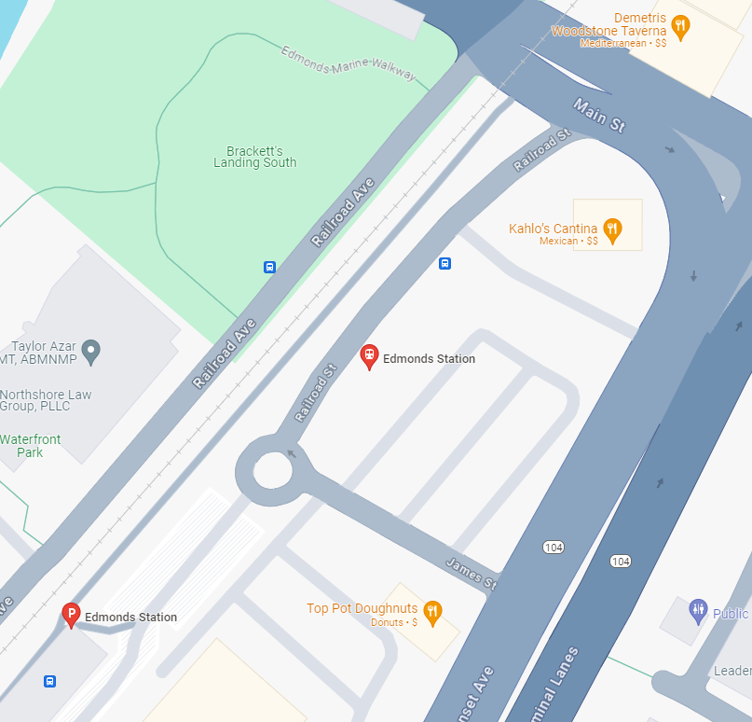
Park & Rides
Edmonds Park & Ride
Edmonds Station
Eliminated routes: 405, 871
Continues to serve: 102
Nearby routes: Swift Blue Line
Eliminated routes: 416
Continues to serve: 102, 130, 166
New routes: 909
Notes:
101, 102, 103, 106, 109, 112, 119, 120, 130, 209, 222, 271, 280

Slide 17
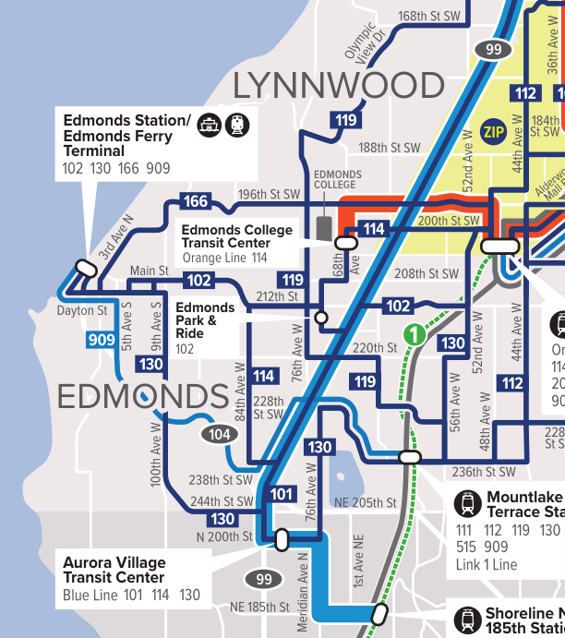
Service in Edmonds
How to connect with light rail
Lynnwood City Center Station
102
114
130
166
Swift Orange Line
Zip Alderwood Shuttle
Mountlake Terrace Station
119
130
909
Shoreline North/185th Station
Swift Blue Line
Notes:
101, 102, 103, 106, 109, 112, 119, 120, 130, 209, 222, 271, 280

Slide 18
Future changes
Transit Changes in 2024 and Beyond - communitytransit.org/transitchanges
Continued increases in service through 2026
21% more service hours will be added
Improvements are scheduled through the service area
13 more routes scheduled for more frequent service (30 min. or better on various days of the week)
Notes:
101, 102, 103, 106, 109, 112, 119, 120, 130, 209, 222, 271, 280

Slide 19
How to learn more
Visit ctgo.org/sept2024
Watch videos about your new route options
View maps of the routes being eliminated and replaced with new routes
Call: 425-353-RIDE (7433)
Use Plan My Trip
Visit Maps & Schedules
Notes:
CHELSEA Share screen and walk through
How to use the webpage
View map and video of eliminated route
View map of my new route
How to use Plan My Trip and Maps & Schedules
Example Plan My Trip

Slide 20
Future opportunities
Sept. 30: Bus tour for seniors from Edmonds Waterfront Center
Oct TBD: Second bus tour for seniors
Notes:
CHELSEA Share screen and walk through
How to use the webpage
View map and video of eliminated route
View map of my new route
How to use Plan My Trip and Maps & Schedules
Example Plan My Trip

Slide 21
Questions
Notes:
Make a Word doc in Sharepoint to list out the questions in order so they can flag who wants to answer

